Slide 1
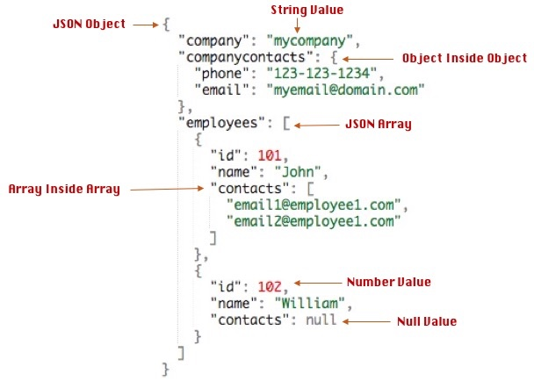
JSON Syntax
JSON
JSON Syntax Rules
Data is in name/value pairs
Data is separated by commas
Curly braces hold objects
Square brackets hold arrays
In JSON, values must be one of the following data types
a string
a number
an object (JSON object)
an array
a boolean
null
JSON Files
The file type for JSON files is ".json"
The MIME type for JSON text is "application/json"

